Slide 1
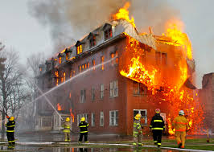
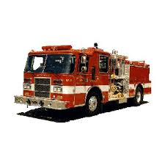
A Future Firefighter
Jahiem Melton

Slide 2
FIREFIGHTER
Firefighters work to prevent fires and save people’s lives and property when fires do happen . Putting out a fire takes teamwork.

Slide 3
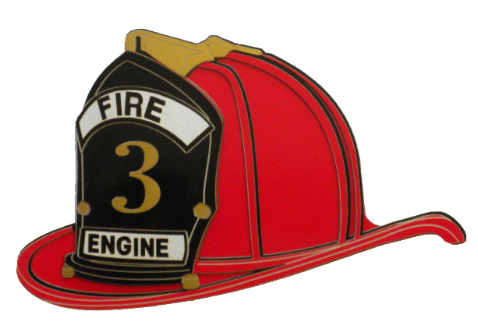
Duties & Responsibilities
According to Virginia Career View , an Firefighter performs the following duties and responsibilities:
Firefighters respond to fire alarms and other emergency calls.
They drive and operate firefighting vehicles and equipment.
They set up and climb ladders to rescues people up high.
Firefighters give first aid , CPR to people who may be injured.
They keep firefighting equipment ,vehicle ,fire hydrants , and the fire station in good working order.

Slide 4
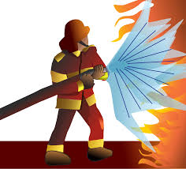
WORKING CONDITIONS
According to Virginia Career View , an Firefighter works under the following conditions:
Firefighters sometimes work shifts of 24 hours including weekends and holidays.
Many Firefighters work more than 50 hours a week.
Firefighting is a job that can be dangerous.

Slide 5
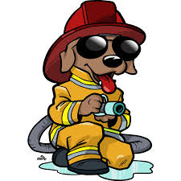
Education and Training/Skills
According to Virginia Career View , and Career Zone , an Firefighter will need the following education , training , and /or skills.
Most Firefighters attend some collages , and many have at least an Associate’s Degree.
There are special tests required to be a firefighter physical and fire safety.

Slide 6
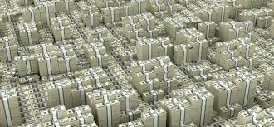
Earnings (Wages)
According to Career Zone an firefighter will earn , on average,$ 713,630.

Slide 7
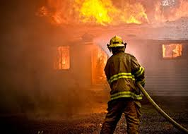
CONCLUSION
My career makes the world a better place by putting out fires and saving people lives.
Yes , because I want to help my community and save people and their belongs.
When you grow up kids would be looking up to you as a role model.
When we have career day I can go outside and see the Fire Trucks.

Slide 8
SOURCES
‘ Firefighter.’ Virginia Career View. Virginia Career View. 11 DEC 2015.
http:// vacareervieww.org/k5/check-it/kids-search/occupation.cfm?id=50

