Slide 1
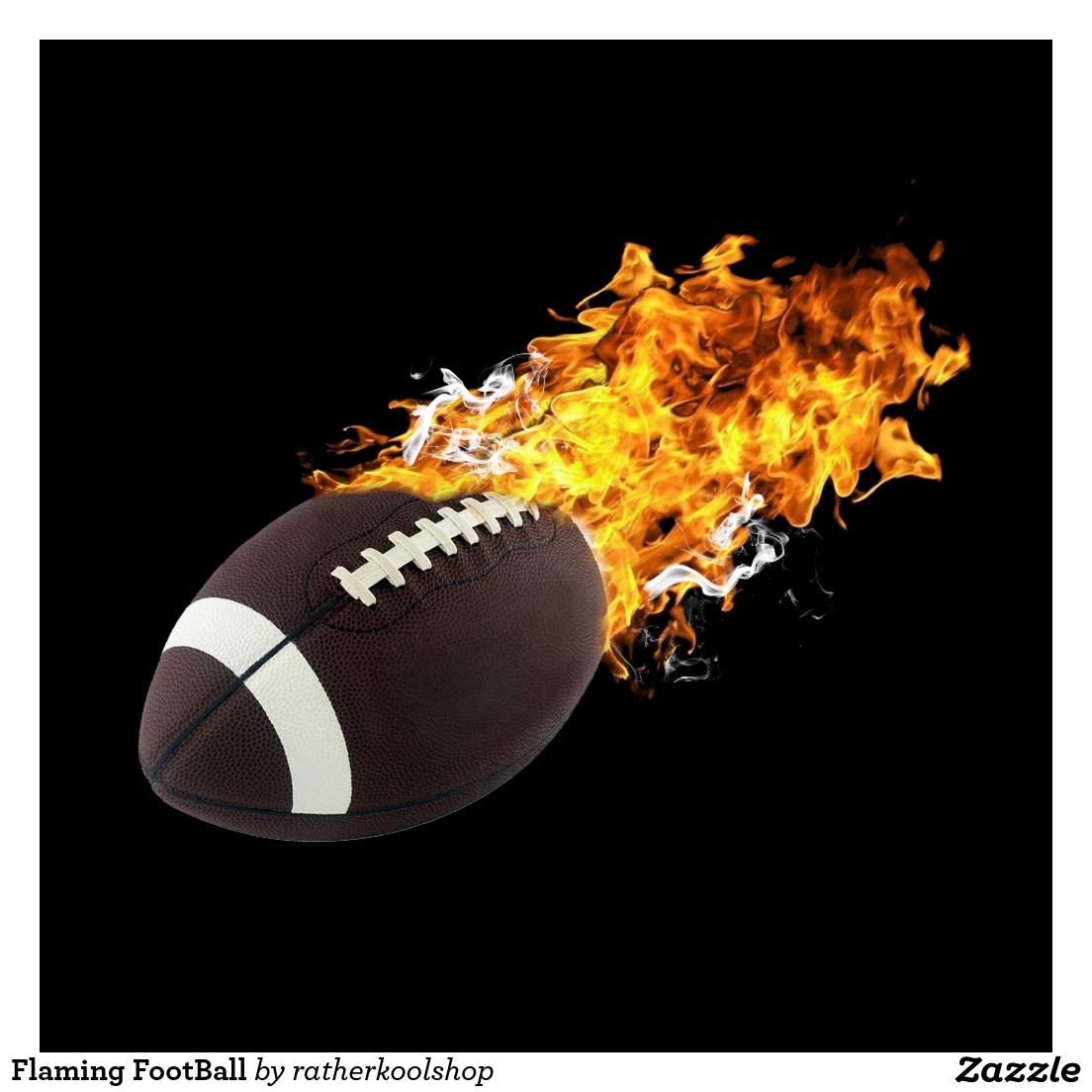
A future football player
Mario Netters Jr.

Slide 2
Football Player
Athletes and sports competitors in sports events as part of a team or alone.

Slide 3
Duties & Responsibilities
According to Virginia Career VIEW, a football player performs the following duties & responsibilities:
Plays sports games.
Exercises and practices.
Is part of a team.

Slide 4
Working Conditions
According to Virginia Career VIEW, a football player works under the following conditions:
Most practice outdoors for many sports.
Some practice indoors.

Slide 5
Education/Training & Skills
According to Virginia Career VEIW… a football will need the following education and training.
Most professional athletes have a bachelor’s degree.
Few professional athlete are recruited out of high school.
Most must at least a high school diploma.

Slide 6
Earnings
According to Career Zone , a football player will earn , an average, $120,920.

Slide 7
Sources
“Athlete/sports’’. Virginia Career VEIW. VirginiaCareerveiw.30 Nov. 15
http://virginiacareerveiw.org/k5/check-it/kids-search/occupation.cfm?id=36

Slide 8
Conclusion
A Football player makes the world a better place by…giving joy and by inspiring a whole bunch of people and making their dreams come true they also help kids achieve their dreams.
After my research, I would like to become a football player because…I get to achieve all of my goals ,and I get to have the chance to become a legend at football for a team called New York Giants.
It is important to study and get a good education now because… I can get recruited right out of high school.
Activities I can participate in now to prepare for my career are…join in other occasion that has to deal with football and run track.

